Slide 1
Threat Hunting Station
CTH 101 Track
Module 7: CTH cases studies and Labs

Slide 2
Outline
CTH Case Studies
What we learn from them?
Let’s Do Something – Lab Introduction
How to get started
Build yourself

Slide 3
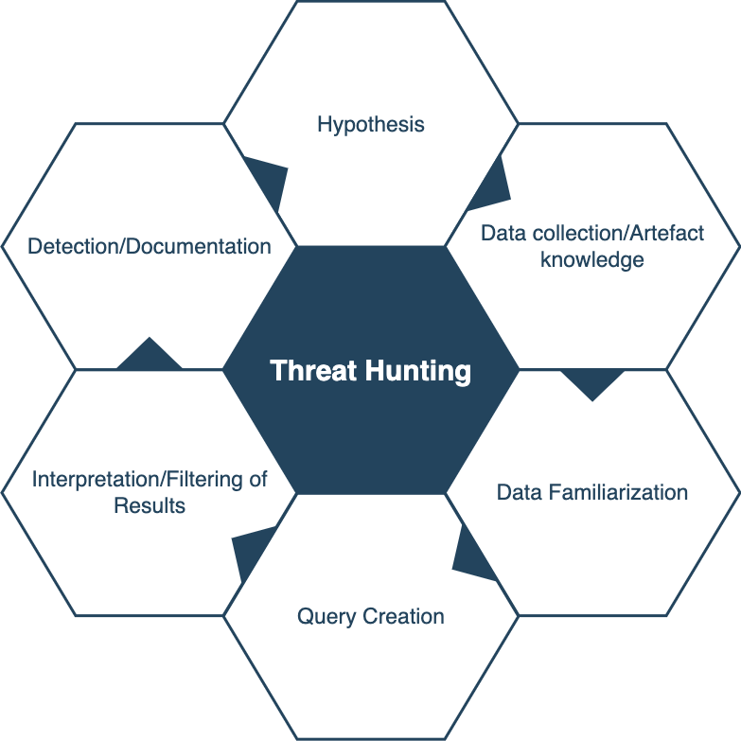
CTH Case Studies
MOVEit Vulnerability
Adversaries use zero-day vulnerabilities to exploit our IIS instance
Adversaries might create/change files on IIS endpoints to execute webshells in our environment
Do we have the data?
Are we collecting IIS logs?
What format the logs are in?
Long tail analysis on the files created, querying what moveitsvc username is performing, massive downloads ,
It is an FTP server, interpreting results from normal to suspicious traffic
Creating atomic detections for the webshell and behavioral detections
Credit: https://www.techtarget.com/searchsecurity/tip/Incident-response-frameworks-for-enterprise-security-teams

Slide 4
CTH Case Studies
https://sayfer.io/blog/bots-and-stolen-funds/
https://www.cybereason.com/blog/threat-hunting-from-lolbins-to-your-crown-jewels
https://www.extrahop.com/company/blog/2018/threat-hunting-basics-a-case-study/
https://www.trustedsec.com/wp-content/uploads/2022/01/017522_TrustedSec_ThreatHuntingLog4j_Case-Study.pdf
https://www.binarydefense.com/case-studies/threat-hunter-finds-renamed-system-utilities-by-file-hash-to-uncover-multiple-attacks/
https://carbonblack.vmware.com/blog/proactive-threat-hunting-case-study-ghostcat
https://www.sans.org/blog/ics-threat-hunting-they-are-shootin-at-the-lights-part-2/
https://blog.cyberproof.com/blog/threat-hunters-arsenal-the-mindset-and-tools-for-proactive-hunting
https://blog.talosintelligence.com/ctir-case-study/
https://www.esentire.com/blog/popular-remote-access-trojan-identified-through-threat-hunting-activities
https://www.fastly.com/blog/threat-hunting-network-callbacks-in-waf-data
https://threatconnect.com/blog/threat-hunting-use-case-sunburst-malware/
https://www.praetorian.com/blog/threat-hunting-how-to-detect-psexec/
https://sanog.org/resources/sanog36/SANOG36-Tutorial_ThreatHunting_Hassan.pdf
Credit: https://www.techtarget.com/searchsecurity/tip/Incident-response-frameworks-for-enterprise-security-teams

Slide 5
Let’s Do Something – Lab Introduction
Testing hypothesis
Learn/improve technical abilities
Experimentation
Certifications
Stumble and fumble

Slide 6
How to get started– Open Source Labs
https://osamaelnaggar.com/blog/threat_hunting_lab1/
https://infosecwriteups.com/threat-hunting-series-using-threat-- emulation-for-threat-hunting-f7ccaa4b85e5
https://github.com/secdevops-cuse/CyberRange
https://www.graylog.org/post/creating-a-threat-hunting-lab-in-graylog/
https://h4cker.org/threat-hunt/
https://activecm.github.io/threat-hunting-labs/
https://cyberwardog.blogspot.com/2017/02/setting-up-pentesting-i-mean-threat.html

Slide 7
Build yourself
Testing hypothesis
Learn/improve technical abilities
Experimentation
Certifications
Stumble and fumble

Slide 8
From MOVEit
Getting vendor specific software is tough
Underlying components and hypothesis is still possible
IIS instance with Sysmon, windows event logs deployed
Default username in administrator group
Kali box to connect to IIS instance
Downloading files from IIS instance – simple python HTTPSERVER
Deploying backdoor (just a sample file) using the established connection
Monitor logs, its behavior

